Slide 1
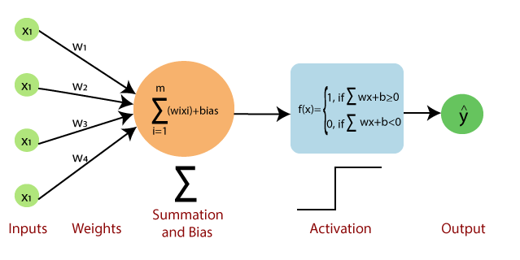
Image Classification using CNN
2223_CV_Laboratory
MAI, Universitat de Barcelona

Slide 2
Training Pipeline
Understand the data
Prepare the data
Define a model
Compile the model
Train the model
Evaluate the model

Slide 3
Understanding the Data - Look at the data before making any assumptions
Analyze and investigate the data sets
Study the main characteristics of the data
Use different visualization tools

Slide 4
Preparing the Dataset
Data cleaning
Missing data
Noisy data
Inconsistent data
Data Transformation
Data normalization

Slide 5
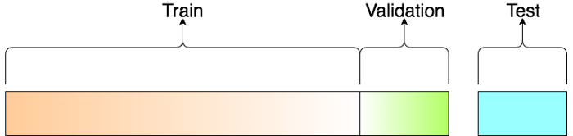
Preparing the Dataset
Create training / validation and test splits
Training set: Data used to fit the model
Validation set: Sample of data used to evaluate the model fit on the training set while making hyper-parameter selections
Test set: Evaluate the final model

Slide 6

Create your Model

Slide 7
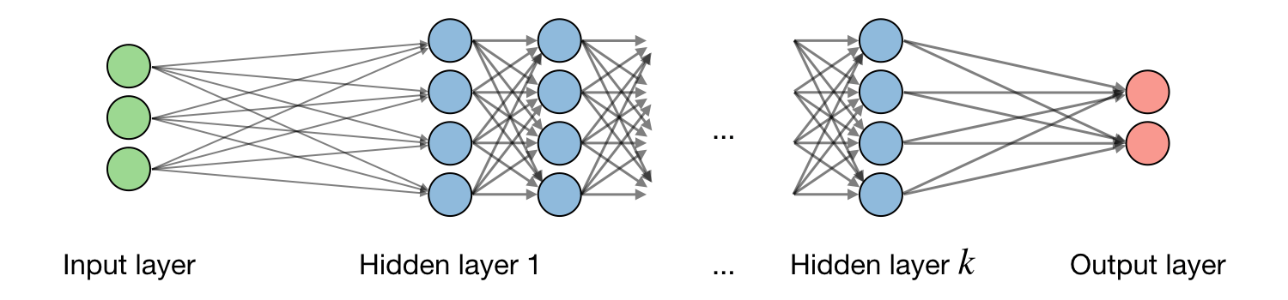
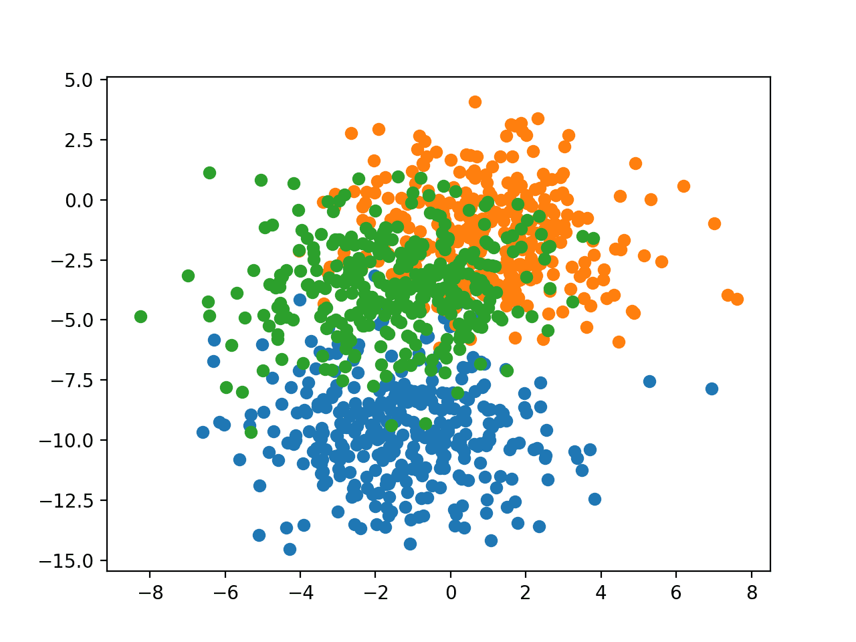
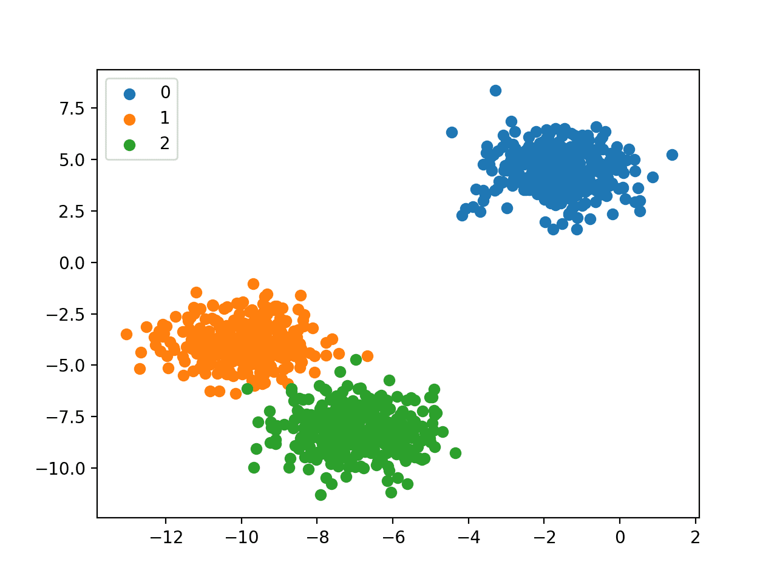
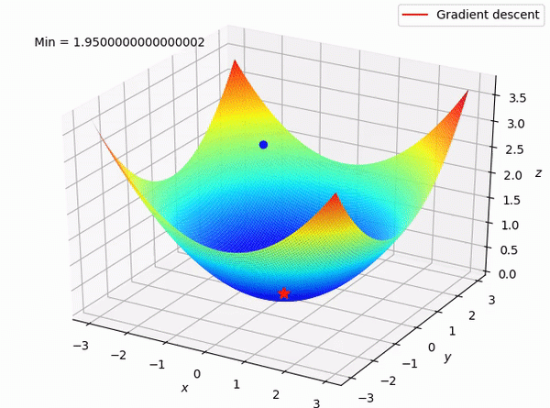
Input
Predictions
Ground truth
Loss
Training Objective
Minimize the loss

Slide 8
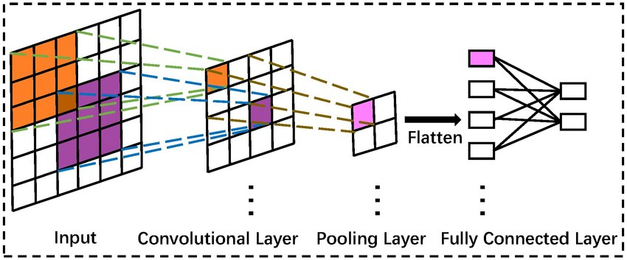
Network Architecture - Layers

Slide 9
Updating weights
Take a batch of training data
Perform forward propagation to obtain the corresponding los
Backpropagate the loss to get the gradients
Use the gradients to update the weights of the network

Slide 10
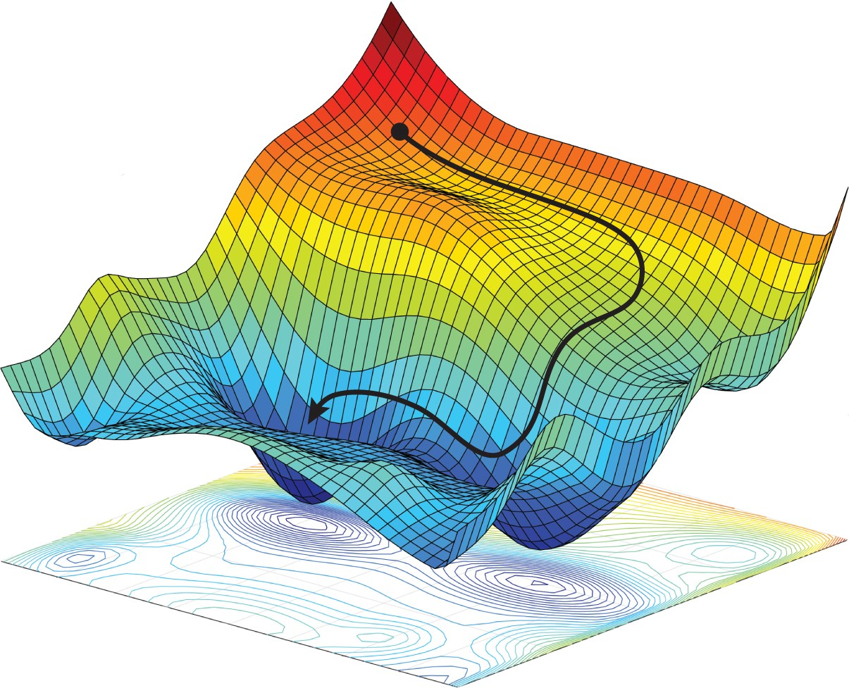
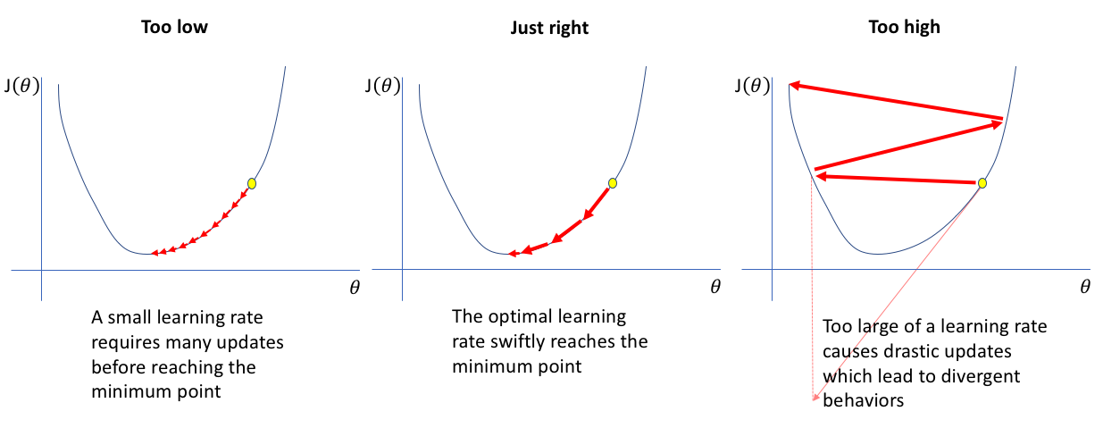
Building your first CNNs – Learning Rate
Optimizers – Algorithms to minimize the loss function
Learning rate – The pace by which the weights get updated
Metrics – Measures of assessment

Slide 11
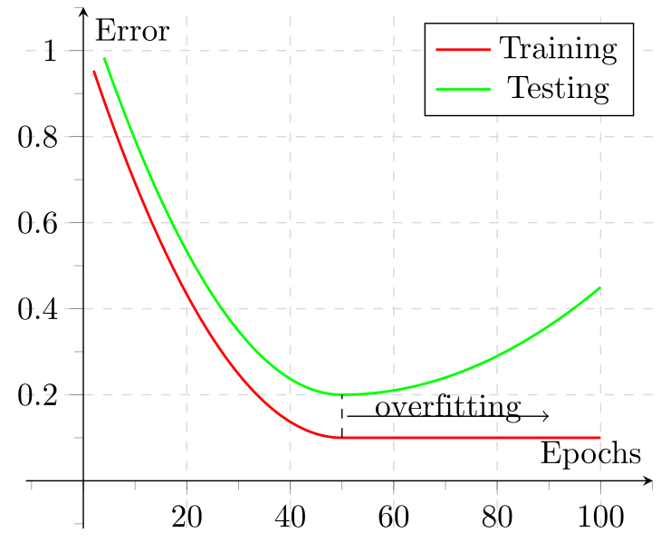
Building your first CNNs – Loss

Slide 12

Deep Learning Tools

Slide 13
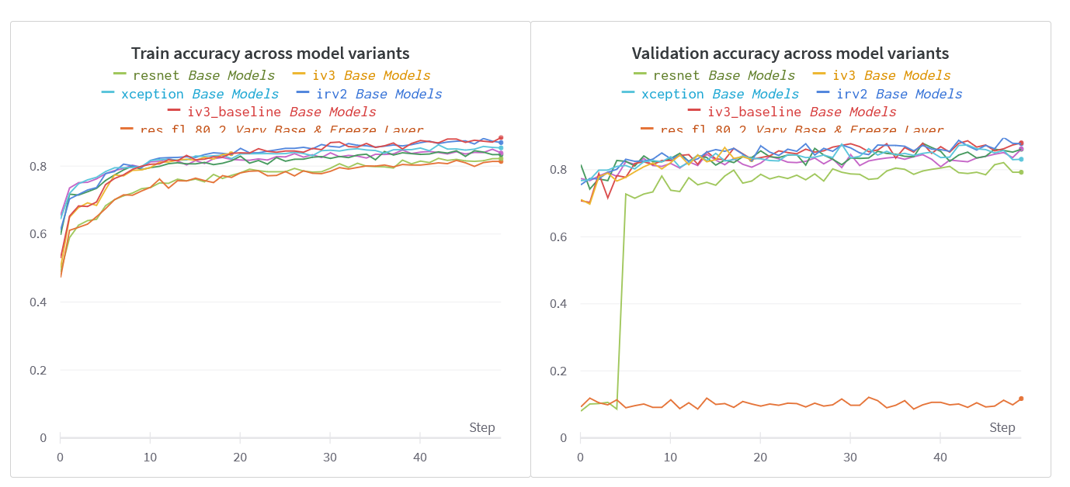
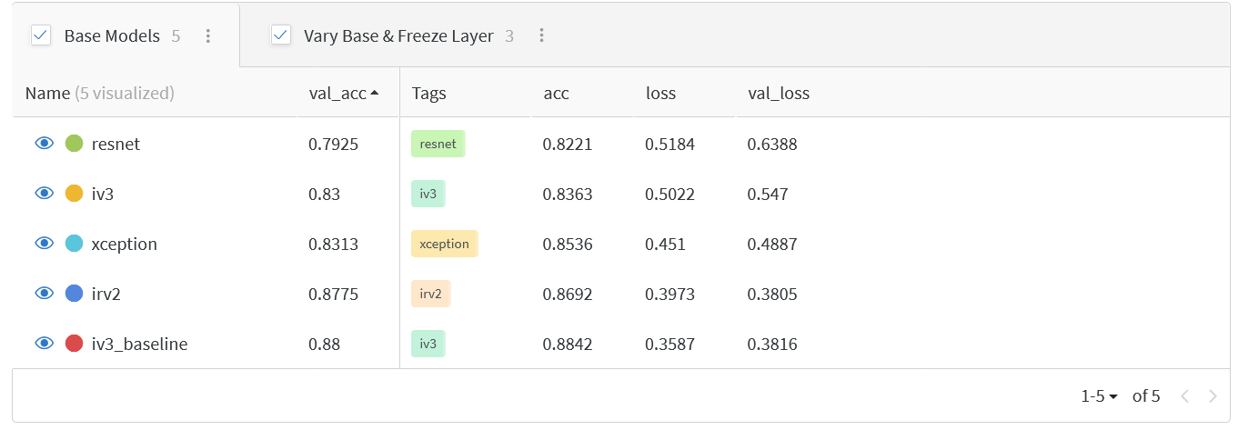
Weights and Biases
MLOps platform that helps in experiment tracking and model management
Visualize results
Evaluate model performances
Can be integrated into any framework

